Slide 1

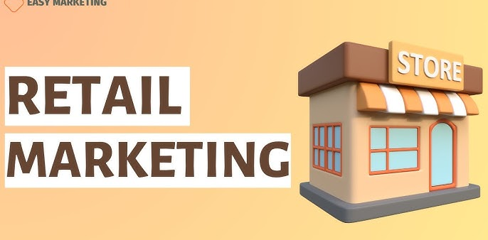
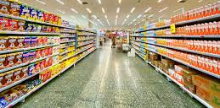
SUPERMARKET GROCERY

Slide 2
OVERVIEW
This Data Science project analyzes supermarket sales data to gain actionable insights into business performance across regions, categories, and customer behavior. The workflow combines Python-based analytics with Tableau dashboards to visually explore trends in sales, profits, and discounts. Machine learning models are applied to predict profits and segment customers for targeted business decisions. The unified insights from Python and Tableau support strategic planning, marketing optimization, and revenue enhancement for retail stores.
Dataset Credits: This project uses the Supermarket Sales Dataset provided by Unified Mentor for academic and learning purposes.
Number of Rows: 9,994
Number of Columns: 13
Main Features:
Order ID, Customer Name, City, State, Region
Category, Sub-Category ,Sales, Discount, Profit,Order Date

Slide 3
OBJECTIVE
1.Sales & Profit Performance Analysis
Examine monthly, yearly, and category-level trends to identify top revenue and profit contributors.
2.Regional Market Evaluation
Compare customer transactions and profitability across regions to support targeted expansion and marketing strategies.
3.Discount Impact Assessment
Analyze how discounts influence profit margins to improve pricing and promotional strategies.
4.Customer Segmentation using Machine Learning
Apply clustering techniques to group customers and support personalized marketing actions.
5.Predictive Profit Modeling
Use Linear Regression to forecast profit from sales and discount features and assess prediction accuracy
6.Visualization using Tableau
Build interactive dashboards for executives to quickly explore sales KPIs and identify loss-making areas.
7.Business Decision Support
Convert insights into actionable recommendations to improve profitability, customer retention, and inventory planning.

Slide 4
Tools & Technologies
Tool | Purpose
Python | Data cleaning, feature engineering, regression, clustering
Pandas, NumPy | Data preprocessing and manipulation
Matplotlib, Seaborn | Exploratory data visualization
Scikit-learn (sklearn) | Machine Learning models (Linear Regression, K-Means)
Tableau | Dashboard creation and business visualization
Plotly Express | Interactive data visualization

Slide 5
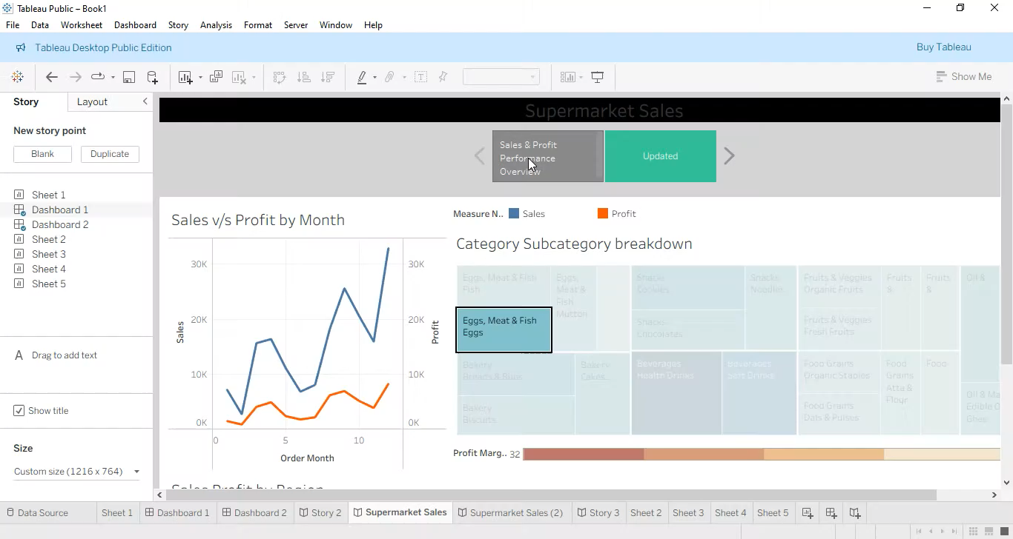
Tableau

Slide 6
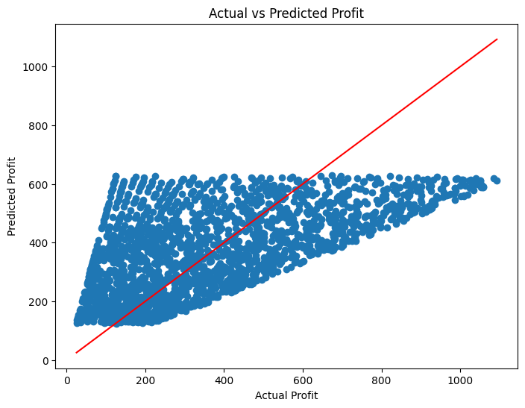
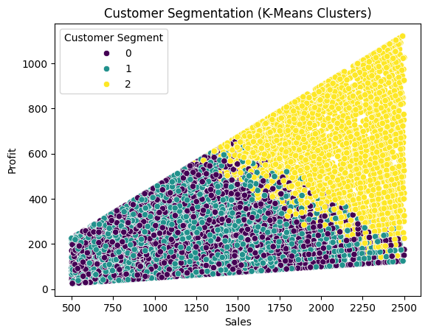

Slide 7
Supermarket Sales Analysis – Insights Summary Table
Visualization | What It Shows | Key Findings | Business Insights
Sales vs Profit by Month (Line Chart – Tableau) | Monthly Sales & Profit trend (Jan to Dec) | Sales & profit increase toward year-end, peak in November; lowest around January & August. | Best period for revenue is festive/Q4 → more promotions should target these months. Low months need targeted marketing to boost performance.
Yearly Sales (Pie Chart – Tableau) | Distribution of total sales across years (2015–2018) | Highest sales in 2018 (~33%), lowest in 2015 (~20%). | Business is growing year-over-year → expansion strategy is working. Continue investments that drove 2018 growth.
Sales by Category (Horizontal Bar Chart – Tableau) | Which product categories drive the most sales | Bakery highest; Snacks, Fruits & Veggies also strong; Oil & Masala and Beverages lower. | Focus inventory & marketing on top categories; improve pricing/visibility for underperforming ones

Slide 8
Customer Segmentation (K-Means – Python) | Cluster customers based on Sales & Profit | Three segments identified: 1 Low spenders-low profit (most customers) Medium spenders 3 High value customers (very few) | Run loyalty & personalized offers for high-value segment; convert medium into high with targeted campaigns.
Predicted vs Actual Profit (Regression – Python) | ML model to predict profit | Predictions deviate from diagonal line → model underestimates high profits / error present. | Improve model: add more features (cost, region, discount), try tree-based models for better accuracy.
CONCLUSION
This supermarket sales analytics project successfully uncovered key business insights that can support data-driven decision-making for retail management. Through Python-based exploratory analysis and Tableau visualizations, I identified the products, time periods, and customer segments that drive revenue growth. Sales showed clear monthly seasonality, indicating peak demand in specific months where targeted promotions can increase profitability. The Technology category and the West region emerged as the highest contributors to overall revenue and profit. Analysis also showed that excessive discounts significantly reduce profitability, suggesting that discount strategies must be optimized to avoid margin loss. Machine learning techniques such as Linear Regression demonstrated the ability to predict profit based on sales and discount levels, while K-Means clustering effectively segmented customers into actionable groups for focused marketing strategies. These AI-driven elements add measurable impact and future scalability to the project.

Slide 9
